Slide 1
Malnutrition in children
Made By-
Alice Tinna
Sarthak Grover

Slide 2
Objective
To identify the prevalence of malnutrition below 5-year-old children in the world.
Data description
We have used Joint child malnutrition estimates (UNICEF-WHO-WB) dataset containing 4 tables each having country, year and percentage of children suffering from a particular form (underweight, stunted, wasted & overweight) of malnutrition.

Slide 3
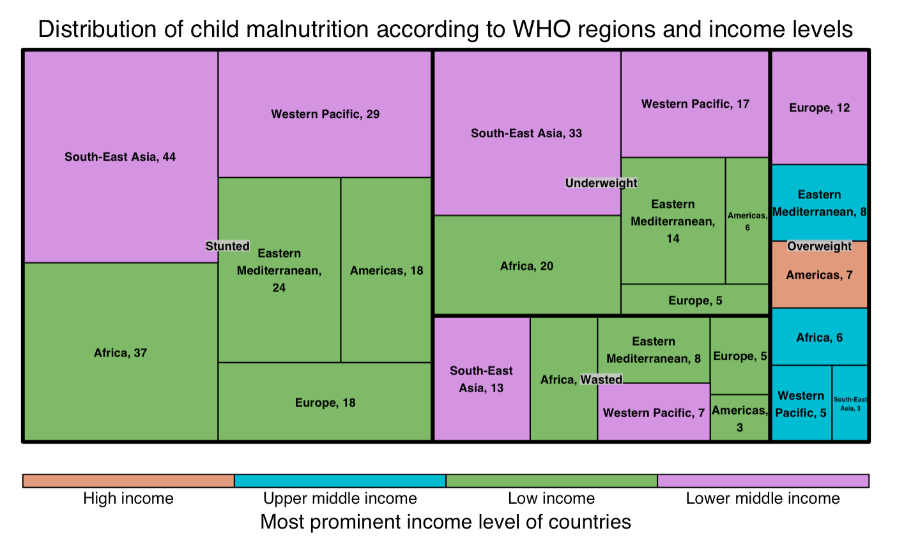
Geographical analysis for different forms of child malnutrition
Inference-
The most common form of child malnutrition is Stunting.
Underweight, Stunting & Wasting is more prominent in low income countries whereas Overweight in High income countries.

Slide 4
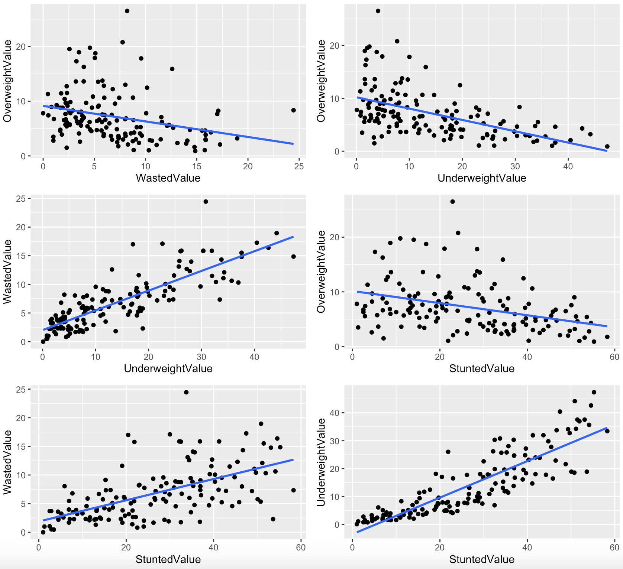
Scatter plots to understand correlation between different forms of child malnutrition
Table showing the correlation values between different forms of child malnutrition
 | Underweight | Stunted | Wasted | Overweight
Underweight | 1 | 0.87 | 0.83 | -0.52
Stunted | 0.87 | 1 | 0.59 | -0.36
Wasted | 0.83 | 0.59 | 1 | -0.29
Overweight | -0.52 | -0.36 | -0.29 | 1

Slide 5
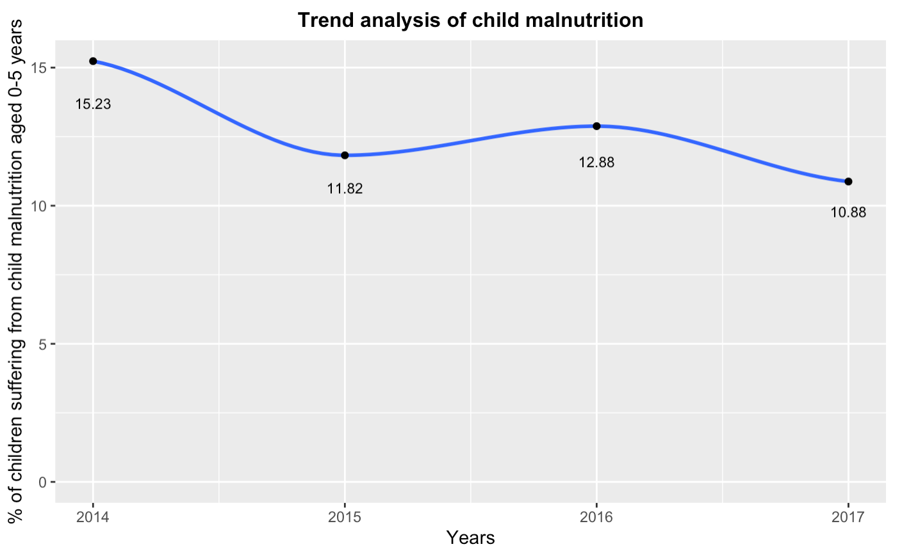
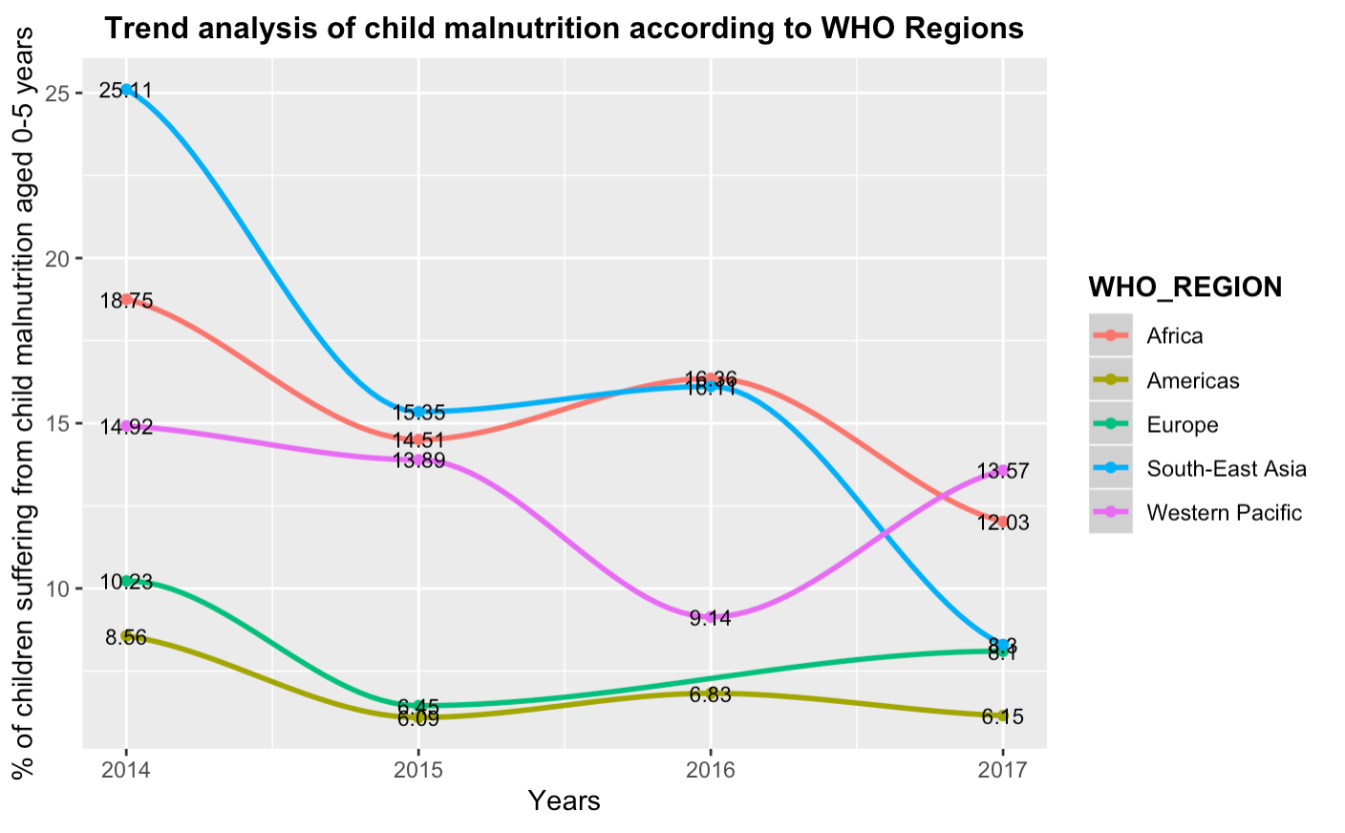
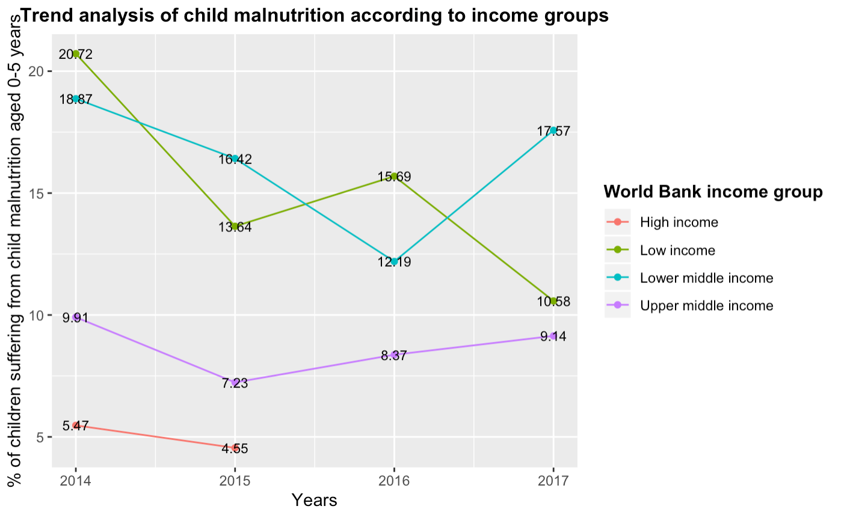
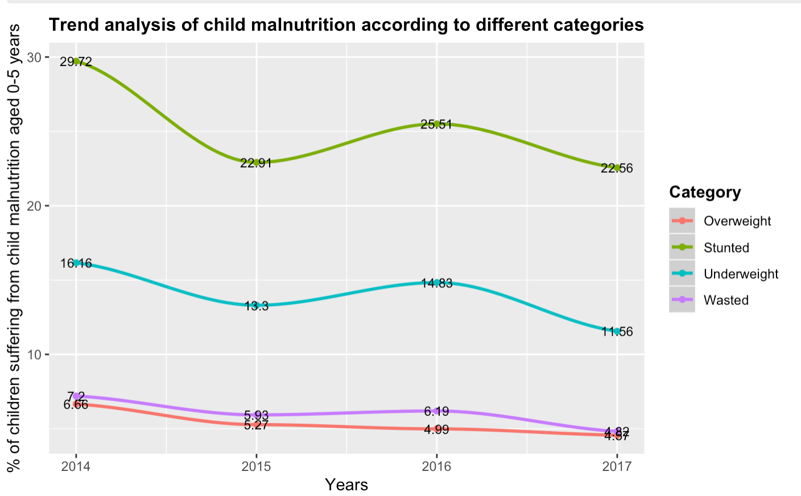

Slide 6
Future Steps
Make the visualizations more interactive by the help of R-Shiny/ Tableau.
Try to do comparison in trends of malnutrition in developing vs developed countries.

